Slide 1

[insert customer logo]
The Future of Flavors in Bakery
April 1, 2020

Slide 2

The Challenge
ZoomEssence
Deliver cost effective taste solutions
Enhance stability in baking, freeze/thaw and frying applications
Create unique sensory experiences
Cost effectively replace liquid flavors

Slide 3

We’ve Done the Work for You
ZoomEssence
Tested & tasted across broad applications
  - Cookies, muffins, cakes, mixes, icing, fillings, donuts
  - Freeze/thaw, baking, frying
  - Withstands high temperature environments
Formulated specifically for bakery segment
Powder delivery system delivers unique advantages

Slide 4
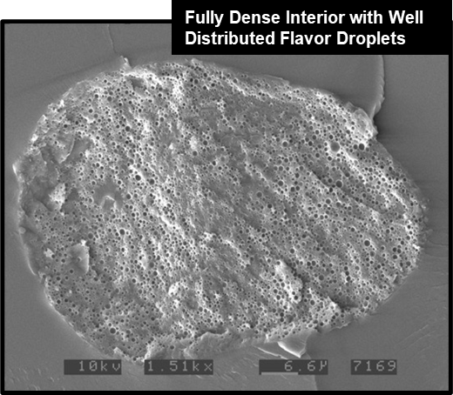
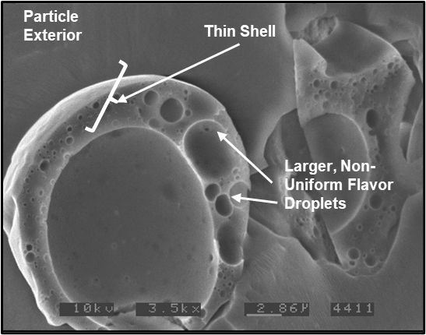
CoolZoom Science Drives Performance
Typical High Heat Spray Dried Powder
CoolZoom Powder
Air Pocket

Slide 5
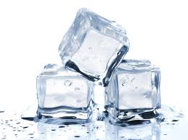
Cost Effective
ZoomEssence
Fruit Preps – Case Study
 | CoolZoom | Liquid Flavor | Change
Use Rate | 0.06% | 0.23% | -74%
Cost / Lb. | $35.00 | $13.00
Cost per Pound of Fruit Prep | $0.02 | $0.03 | -30%

Slide 6
Cost Effective
ZoomEssence
Lower Usage Rates with Significant Savings in Cookies
 | CoolZoom | Standard Flavor | Change
Use Rate | 0.10% | 0.20% | -50%
Cost / Lb. | $14.00 | $10.00
Cost per Pound of Cookies | $0.015 | $0.02 | -30%

Slide 7

ZoomEssence
Lower Cost in Use
Better Stability
More Aroma & Taste
Significant Performance
in Bakery
Beverage
Capabilities
Great Aroma & Taste
Replace Liquid Flavors

Slide 8
Tasting
ZoomEssence
Cookies
  Blueberry
  Lemon
  Vanilla
  Butter
  Salted Caramel
  Coffee
Icing
  Blueberry
  Lemon
  Vanilla
  Butter
  Whipped Cream
  Coconut
  Salted Caramel
  Coffee

Slide 9
Demo Formulations
ZoomEssence
Cookie Screening Base
Ingredients | %
All Purpose Flour | 44.06
Palm Shortening | 22.54
Sugar | 19.63
Egg | 10.51
Maltodextrin | 2.91
Salt | 0.29
Baking Powder | 0.06
 | 100.00
Icing Screening Base
Ingredients | %
Confectioner's Sugar | 57.00
Vegetable Shortening | 28.53
Water | 10.69
Sunflower Oil Powder | 3.58
Maltodextrin | 0.20
 | 100.00

Slide 10
CoolZoom Natural Flavor Technology
Blueberry
Cookie
Lemon
Cookie
Vanilla
Cookie
Natural Blueberry 0.20%
Jammy, Floral, Fresh
Natural Lemon 0.20%
Juicy, Green, Fresh Squeezed
Natural Vanilla 0.25%
Brown Buttery, Sweet, Dark

Slide 11
CoolZoom Natural Flavor Technology
Butter
Cookie
Whipped Cream
Cookie
Salted Caramel
Cookie
Coffee
Cookie
Natural Butter 0.75%
Fatty, Creamy, Dairy
Natural Whipped Cream 0.75%
Creamy, Fatty, Dairy
Natural Salted Caramel 0.40%
Sweet Brown, Cooked, Buttery
Natural Coffee 0.20%
Brown, Dark Roast

Slide 12
CoolZoom Natural Flavor Technology
Blueberry
Icing
Lemon
Icing
Vanilla
Icing
Natural Blueberry 0.20%
Ripe, Floral, Fruity
Natural Lemon 0.40%
Juicy, Peely, Terpene
Natural Vanilla 0.30%
Brown, Creamy, Custard

Slide 13
CoolZoom Natural Flavor Technology
Butter
Icing
Whipped Cream
Icing
Toasted Coconut
Icing
Natural Butter 0.55%
Creamy, Sweet, Mild
Natural Whipped Cream 0.75%
Creamy, Milky, Sweet
Natural Coconut 0.25%
Cooked, Lactonic, Caramel

Slide 14
CoolZoom Natural Flavor Technology
Salted Caramel
Icing
Coffee
Icing
Natural Salted Caramel 0.30%
Cooked Sugar, Sweet, Brown
Natural Coffee 0.30%
Roasted, Coffee Grounds, Dark

Slide 15


