Slide 1


Flavor Capabilities
& Bar Application
Joe Santaiti
Pat Horning
Starla Paulsen
June 4, 2020

Slide 2
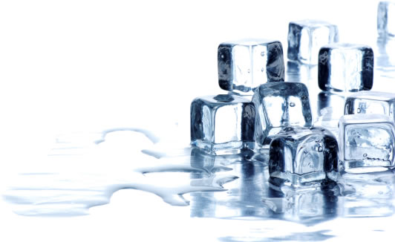
About ZoomEssence
Zooming® is Low-Temperature Drying
Designed for
Heat-Sensitive Flavors and Naturals
Delivering Unmatched Quality in Aroma and Taste
Notes:
Our focus at ZoomEssence is to deliver the highest quality in aroma & taste of flavors and naturals ingredients using
our Low-Temperature drying process which we call Zooming.

Slide 3

About ZoomEssence
Headquarters & Creation Center, Hebron, KY
  Flavorists
  R&D Scientists
  Beverage & Culinary Applications
  Analytical & Regulatory
  Sales & Customer Service
5 Drying Systems in 2 Manufacturing Facilities
  Hebron, KY
  Sayreville, NJ
Notes:
We are headquartered in Hebron KY, along with our Creation Center which includes

Slide 4

About ZoomEssence
Lead Time for First-Time Production is 4 to 5 weeks
  Depending on Availability of Raw Materials
Lead Time for Additional Orders is 3 weeks
  Stocking Agreements are Available
Minimum Order 20 Kgs
  Pack Size 10 Kgs Box
  Ambient Storage
Notes:
The box is half the size of a standard box from a traditional flavor house

Slide 5
It’s About Zooming Efficiency
Traditional Spray Dry
CoolZoom® Powder
Dried @Temperatures
350-400F
Dried @Temperature ~110F
30%+ Loss of Flavor & Aroma Actives
95 to 100% Retention of Flavor & Aroma Actives
Particle Size Avg 50micron
Particle Size Avg 100micron
Bulk Density
High Surface Area
Bulk Density
Fully Dense, Low Surface Area
Notes:
You may be wondering what the differences are between traditional spray dry powder and CoolZoom powder.

Slide 6
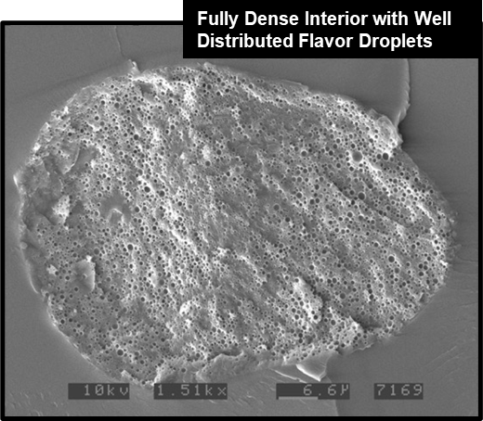
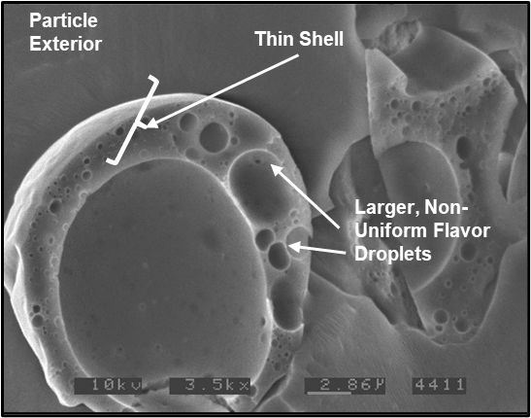
CoolZoom Science Drives Performance
Typical High Heat Spray Dried Powder
CoolZoom Powder
Air Pocket
Notes:
What does the difference between fully dense surface area look like?

Slide 7

CoolZoom Has Better Dispersibility
CoolZoom Spray Dry
0.50g Powder / 250ml Water
Notes:
Larger particle and fully dense allow for better dispersibility.

Slide 8

ZoomEssence Capabilities
Flavor Matching
Flavor
R&D and Application
Sciences
Prototype Development
Beverage
Capabilities
Formula Transparency
Collaboration & Customization

Slide 9
ZoomEssence Bar Applications
Specialty: Cookies & Brownies
Extruded
Granola
Slab
Baked

Slide 10
ZoomEssence
    Artificial
    N&A
    Natural Flavors
    TDNS Flavors
    (Totally Derived from Natural Source)
      Oils, Extracts,
      Oleos, Essences
      -Herbs
      -Citrus
      -Spices
      -Vegetables
    Non-GMO
    Gluten-Free
    Vegetarian
    Vegan
    Kosher
    Clean Label / Free From
    Organic Certifiable
      & Certified (when requested)
80% of taste is aroma
-Using heat distorts to create your powder flavor destroys the natural volatiles-
Notes:
We offer a wide variety of flavors that meet your labeling requirements.

Slide 11
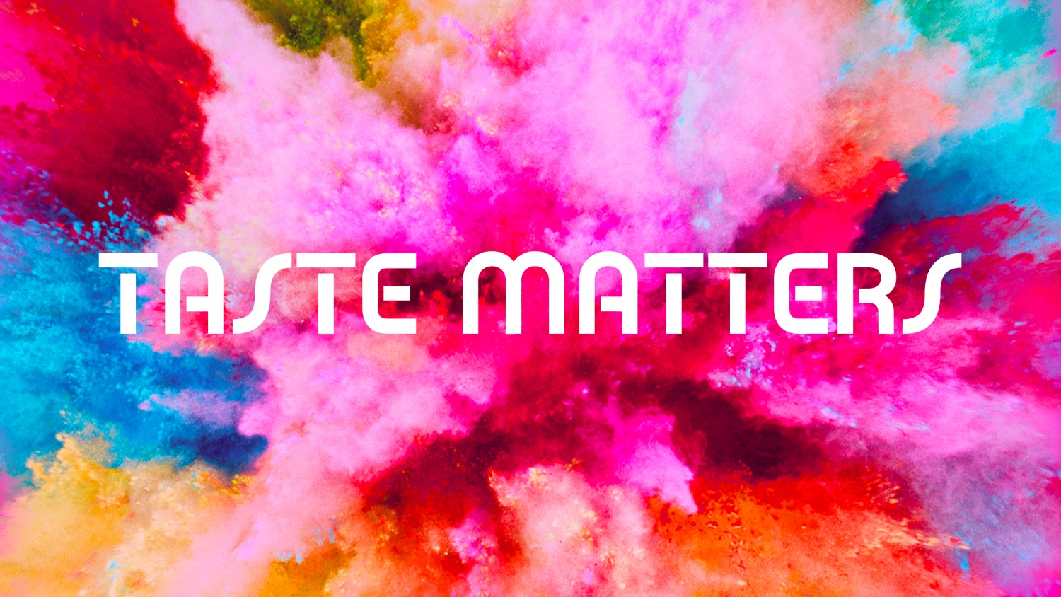

Slide 12
The Challenge
ZoomEssence
Many Bar Bases are Challenging to Flavor
Traditional Liquid Bar Flavors Fade Over Time
Customized flavors for Bars Don’t Exist
Notes:
Challenge because of wide variety of trend ingredients in bases.

Slide 13
ZoomEssence
We’ve Done the Work for You
Tested in Challenging 20g High Protein Bases
  -Mask First, then Flavor
We had to Formulate Flavors Differently to Optimize their Performance
Commonalities in Formulation Appeared, Leveraging our Strength
Notes:
Mask first using our Natural Masking Flavor, cleaner tasting base, easier to flavor
We studied the performance of flavors in the application and adjusted the flavor formulations based on the interaction with the protein matrix.
We created flavors that are well-encapsulated and highly concentrated. Usage levels are a 1/10 of what a normal flavor (liquid or powder) would be in this application.
3) We find consistent usage levels in application (0.20-0.40%) as well as stability once applied in the bar

Slide 14
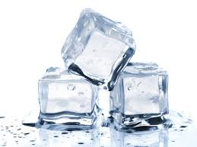
ZoomEssence
Cost Effective
Lower Usage Rates with Significant Savings
 | CoolZoom | Standard Flavor
Use Rate | 0.20% | 2.00%
Cost / Lb. | $25.00 | $25.00
Flavor per 50g Bar | 0.10 g | 1.00 g
Cost per 50g Bar | $0.005 | $0.050
90% Cost Reduction

Slide 15

ZoomEssence
Better Stability
More Aroma & Taste
More Aroma & Taste
Significant Performance
in Bars
Beverage
Capabilities
Low Usage Rates
Less Cost in Use

Slide 16
Tasting
ZoomEssence
Set 1
Natural Masking Technology
Set 3
Natural Cupcake
Natural French Vanilla
Natural Chocolate
Natural Dark Chocolate
Set 2
Natural Raspberry
Natural Vanilla Latte
Natural Dirty Chai

Slide 17
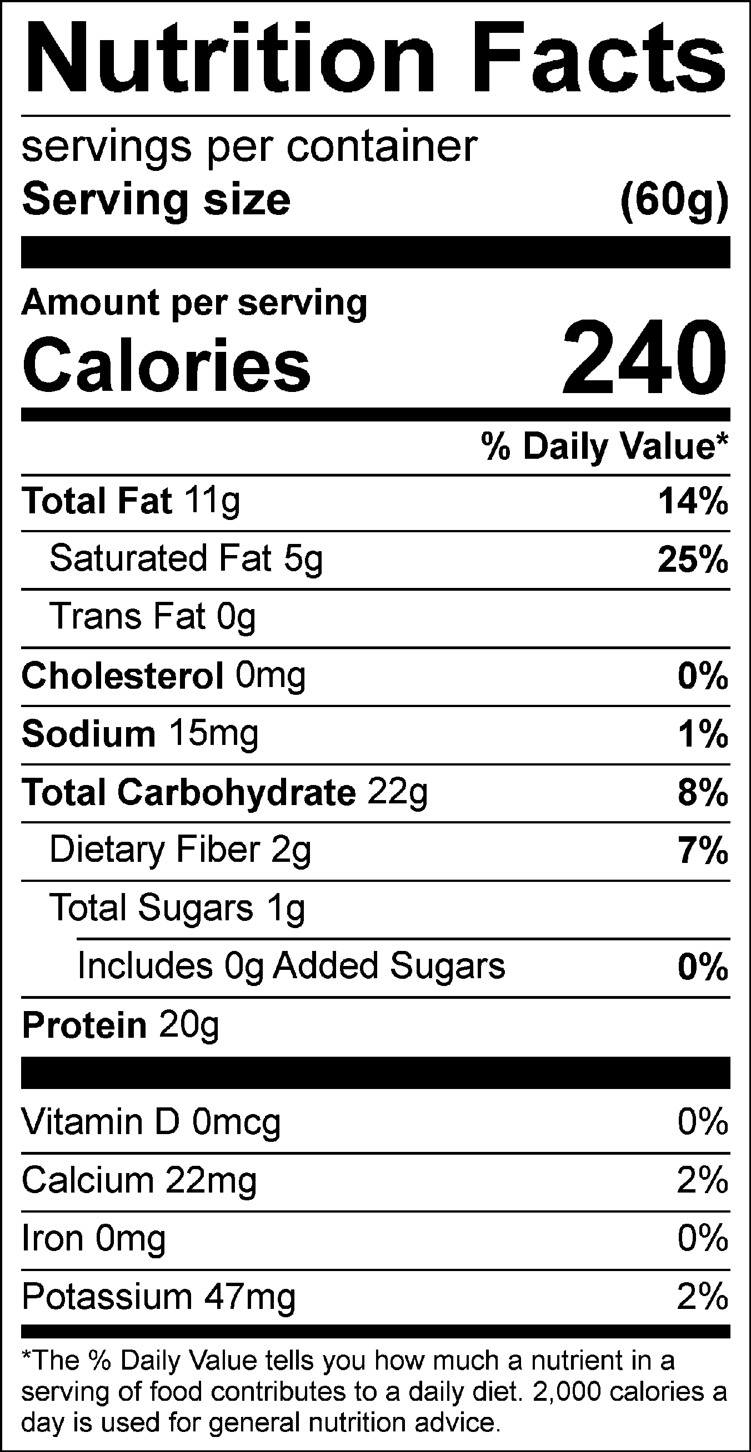
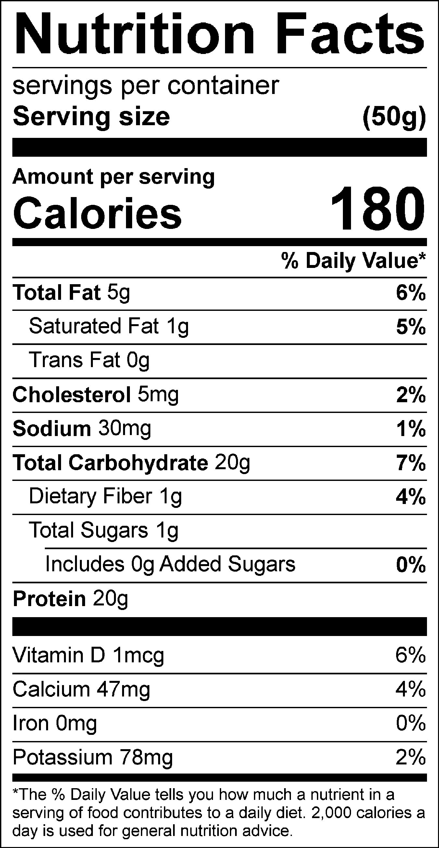
ZoomEssence
CoolZoom Natural Masking Technology
Control
No flavor
Plant Base
Ze Masker
Flavor @0.20%
Plant Base
Control
No flavor
Whey Base
  Ze Masker
  Flavor @0.20% Whey Base
1

Slide 18
Protein Bar Formulations
ZoomEssence
Whey Base Screening Base
Ingredients | %
Vita Fiber | 22.59
Soft Haven 1000 | 20.12
Soft Haven 80 | 11.48
Maltitol | 11.39
Almond Butter | 11.05
Soft Haven 5000 | 10.05
Glycerine | 9.05
Oil | 3.87
Lecithin | 0.20
Ze Nat Masking Flavor | 0.20
 | 100.00
Plant Base Screening Base
Ingredients | %
Pea Protein (Glanbia) | 31.23
Vitafiber | 18.80
Almond Butter | 11.55
Pea Protein (Puris) | 10.40
Maltitol | 10.27
Palm Oil | 10.00
Glycerine | 7.05
Lecithin | 0.50
Ze Nat Masking Flavor | 0.20
 | 100.00
1

Slide 19

ZoomEssence
CoolZoom Natural Flavor Technology
Raspberry
Whey Base
Vanilla Latte
Whey Base
Dirty Chai
Whey Base
Natural Raspberry 0.35%
Natural Masker 0.18%
Natural Coffee 0.35%
Natural Cupcake 0.18%
Natural Masker 0.18%
Natural Chai Spice 0.35%
Natural Coffee 0.35%
Natural Masker 0.18%
Fruity Raspberry
Flavor & Aroma
White Cake Vanilla, Full Coffee Aroma & Flavor
Smooth & Milky,
Fragrantly Spiced,
Mild Coffee Flavor
2

Slide 20
Whey Protein Bar Formulations
ZoomEssence
Raspberry
Ingredients | %
Soft Haven 1000 | 17.67
Fibersol | 14.94
Glycerine | 13.67
Soft Haven 80 | 10.09
Maltitol | 10.01
Almond Butter | 9.72
Soft Haven 5000 | 8.83
Coating | 8.79
Oil | 5.71
Ze Natural Raspberry WONF | 0.35
Ze Natural Masker Flavor | 0.18
Lecithin | 0.04
 | 100.00
Vanilla Latte
Ingredients | %
Soft Haven 1000 | 17.82
Fibersol | 14.89
Glycerine | 13.62
Soft Haven 80 | 10.05
Maltitol | 9.98
Almond Butter | 9.68
Soft Haven 5000 | 8.80
Coating | 8.75
Oil | 5.69
Ze Nat Coffee WONF | 0.35
Ze Natural Masker Flavor | 0.18
Ze Nat Flavor Cupcake Type | 0.18
Lecithin | 0.04
 | 100.00
Dirty Chai
Ingredients | %
Soft Haven 1000 | 17.61
Fibersol | 14.89
Glycerine | 13.62
Soft Haven 80 | 10.05
Maltitol | 9.98
Almond Butter | 9.68
Soft Haven 5000 | 8.80
Coating | 8.76
Oil | 5.69
Ze Natural Chai Spice | 0.35
Ze Nat Coffee WONF | 0.35
Ze Natural Masker Flavor | 0.18
Lecithin | 0.04
 | 100.00
2

Slide 21
ZoomEssence
CoolZoom Natural Flavor Technology
Cupcake
Whey Base
Dark Chocolate
Whey Base
Natural Cupcake Flavor 0.10%
Natural Masking Flavor 0.18%
Vanilla & White Cake Notes
Natural Dark Chocolate 0.35%
Natural Masking 0.20%
Floral, Dark Chocolate Notes
French Vanilla
Whey Base
Chocolate
Whey Base
Natural French Vanilla 0.10%
Natural Masker 0.18%
Classic, Rich, Eggy Vanilla
Natural Chocolate 0.35%
Natural Masking 0.20%
Milky, Chocolate Cake Notes
3

Slide 22
Whey Protein Bar Formulations
ZoomEssence
Cupcake & French Vanilla
Ingredients | %
Soft Haven 1000 | 17.67
Fibersol | 15.19
Glycerine | 13.67
Soft Haven 80 | 10.09
Maltitol | 10.01
Almond Butter | 9.72
Soft Haven 5000 | 8.83
Coating | 8.79
Oil | 5.71
Ze Natural Flavor | 0.10
Ze Natural Masker Flavor | 0.18
Lecithin | 0.04
 | 100.00
Dark Chocolate & Chocolate
Ingredients | %
Soft Haven 1000 | 17.67
Fibersol | 14.94
Glycerine | 13.67
Soft Haven 80 | 10.09
Maltitol | 10.01
Almond Butter | 9.72
Soft Haven 5000 | 8.83
Coating | 8.79
Oil | 5.71
Ze Natural Flavor | 0.35
Ze Natural Masker Flavor | 0.18
Lecithin | 0.04
 | 100.00
3

Slide 23


