Slide 1

[insert customer logo]
The Future of Flavors in Beverages
February 11, 2020

Slide 2

The Challenge
ZoomEssence
Fact: Traditional spray dried powder flavors are not as good as liquid flavors
Liquid flavors struggle with diluents and fail to deliver aroma
Many Sports Nutrition Beverage Bases are Challenging to Flavor

Slide 3
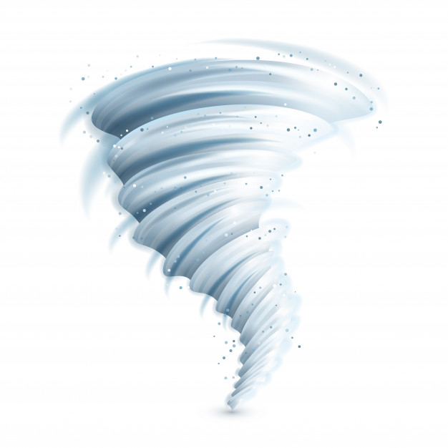
We’ve Done the Work for You
ZoomEssence
Tested in the most Challenging Beverage Bases both Powder and Liquid formats
  -Mask First and neutralize, then Flavor
For RTDs harsh processing conditions can impact aroma and taste when using liquid flavors, not for Coolzoom.
Better performance in powder and better flavor delivery format in RTD, i.e. ease of use at manufacturing level

Slide 4
We’ve Done the Work for You
ZoomEssence
Vs Traditional Spray Dried Flavors
2-3X lower Cost-in-Use
Lower calorie & carbs
Higher quality flavor = Better retention of volatiles
Longer shelf life by 9-12 months
Better dispersion and hydration
Possibility of reduced excipient levels

Slide 5
We’ve Done the Work for You
ZoomEssence
Vs Traditional Liquid Flavors
Up to 2X lower Cost-in-Use
Mixes with other dries
No flashpoint worries or carrier interactions
Lower freight costs with no HazMat shipping
Longer Shelf Life by 6-12 months

Slide 6
We’ve Done the Work for You
ZoomEssence
Product Applications
Less carbs & calories with lower use level = 0.05-0.15%
Pair with Masking Flavors to mitigate base deficiencies to mask bitterness, etc.
Pair with Natural Enhancer Flavors for Sweetness, Dairy, Salt, etc. to reduce excipients
Flavor profiles and use levels are often contingent upon protein levels and processing conditions
Sufficient product aging must be allowed for complete flavor development

Slide 7
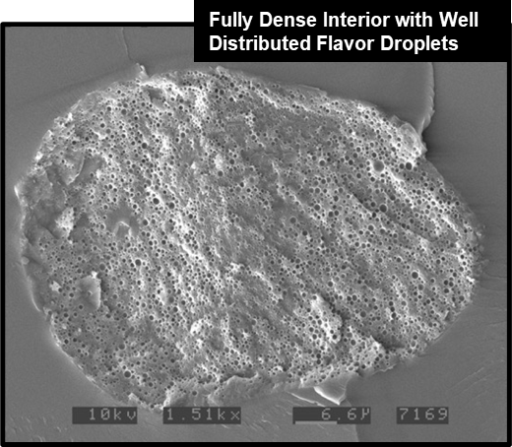
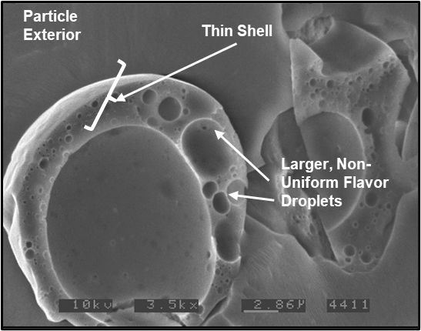
CoolZoom Science Drives Performance
Typical High Heat Spray Dried Powder
CoolZoom Powder
Air Pocket

Slide 8
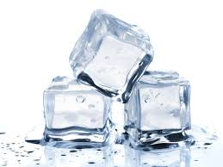
Cost Effective
ZoomEssence
Lower Usage Rates with Significant Savings
Orange Cream RTD Beverage
 | Original Formula | CoolZoom | Difference
 | ml | ml | % Change
Unflavored Base | 340.0 | 340.0 | .0%
N&A Flavor | 0.7% | 0.1% | (85.71%)
Total Serving

Slide 9
Cost Effective
ZoomEssence
Lower Usage Rates with Significant Savings
Powdered Soft Drink Beverage
 | gm | Market Product Cost/KG | Cost per Serving | CoolZoom Version | gm | Cost/KG | Cost Per Serving
Base | 15.98 |  |  | Base | 16.18
Lemonade Flavor | 0.29 | $17.64 | $0.0051 | CoolZoom Lemonade Flavor | 0.09 | $39.25 | $.00352
Total | 16.27 |  |  |  | 16.27
Flavor Use Rate | 1.78% |  | $.00511 |  | .5606% |  | $0.00352

Slide 10

Enhanced Stability
Incredible Solubility
Significant Performance
in Beverages
More Aroma & Taste
Beverage
Capabilities
More Aroma & Taste
Low-Temperature
Zooming® Technology
Low Usage Rates
Less Cost in Use
Low Usage Rates

Slide 11
Tasting
ZoomEssence
Aroma!!!!
Customized to type of customer and current challenges

Slide 12
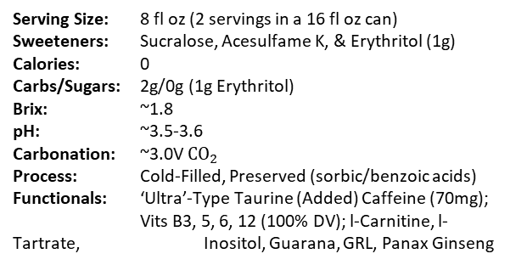
CoolZoom Carbonated Energy RTD
Carbonated Energy RTD
Objective:
Demonstrate CoolZoom® Powder Flavors in carbonated energy RTD’s
Serving Size: 8 fl oz (2 servings in a 16 fl oz can)
Sweeteners: Sucralose, Acesulfame K, & Erythritol (1g)
Calories: 0
Carbs/Sugars: 2g/0g (1g Erythritol)
Brix: ~1.8
pH: ~3.5-3.6
Carbonation: ~3.0V ${CO}_{2}$
Process: Cold-Filled, Preserved (sorbic/benzoic acids)
Functionals: ‘Ultra’-Type Taurine (Added) Caffeine (70mg); Vits B3, 5, 6, 12 (100% DV); l-Carnitine, l-Tartrate, Inositol, Guarana, GRL, Panax Ginseng
CO2 Energy Bev - Lemon Flavor
PR003190
Featuring Lemon Powder Flavors:
Ze Natural Lemon Flavor
FD&C Yellow #5 for Color
Estimated Label:
Carbonated Water, Citric Acid, Taurine, Erythritol, Sodium Citrate, Natural Flavors, L-Carnitine, L-Tartrate, Potassium Sorbate, Caffeine, Sucralose, Acesulfame Potassium, Sodium Benzoate, Calcium Pantothenate, Niacinamide, Salt, Panax Ginseng Extract, Guarana Seed Extract, Inositol, Glucoronolactone, Pyridoxine Hydrochloride, FD&C Yellow #5, Cyanocobalamin

Slide 13
CoolZoom Carbonated Energy RTD
Protein + Energy RTD
Objective:
Demonstrate CoolZoom® Powder Flavors in a clear protein RTD with a sports/energy spin
Serving Size: 8 fl oz
Protein: 10g (WPI)
Sweeteners: Dextrose, Sucrose & Sucralose
Calories: 80
Carbs/Sugars: 10g/9g
Brix: ~10.1
pH: ~3.20
Process: Hot-Filled
Functionals: Dextrose (5,000mg); (Added) Caffeine (60mg);
BCAA’s 2:1:1 (200mg);
Vits B2,3,5,6,12 (100% DV)
90mg Sodium; 30mg Potassium
Tropical Punch Flv Protein-Energy RTD
PR002936
Featuring Lemon Powder Flavors:
Ze Natural Lemon Flavor
FD&C Yellow #5 for Color
Estimated Label:
Water, Whey Protein Isolate, Dextrose, Sucrose, Citric Acid, Sodium Citrate, Natural and Artificial Flavors,
BCAA Blend (Leucine, Isoleucine, Valine), Malic Acid, Potassium Citrate, Salt, Caffeine, Sucralose, Calcium Pantothenate, Niacinamide, Guar Gum, Pyridoxine Hydrochloride, FD&C Red #40, Riboflavin, Cyanocobalamin

Slide 14
CoolZoom Cold Brew Coffee Latte RTD
Objective:
Demonstrate CoolZoom® Powder Flavors in retorted coffee RTD’s
Cold Brew Coffee Latte RTD
Serving Size: 13.7 oz/450ml
Coffee Source: Cold Brew Coffee Extract
Milk Source: Reduced Fat Milk @ ~50%
Sweetener: Sucrose, Stevia
Calories: 190
Fat: 4g
Sodium: 190mg
Total Carbs: 32g
Total Sugars: 29g
(Added) 19g
Protein: 8g
Caffeine: 90mg (all from coffee)
Stabilizer: DKP & pH Adjustment (no gums)
Process: Retort Sterilized
Salted Caramel Flavor Coffee Latte
PR003020
Featuring Flavors:
Ze Natural Salted Caramel Coffee Type Flavor
Natural Dairy Enhancer Flavor
Estimated Label:
Cold Brew Coffee (Water, Cold Brew Coffee Extract), Reduced Fat Milk, Sugar, Natural Flavors, Dipotassium Phosphate, Salt, Stevia Leaf Extract

Slide 15
CoolZoom Cold Brew Coffee Latte RTD
RTD Cold Brew Coffee Latte
Objective:
Demonstrate CoolZoom® Powder Flavors in an
RTD Coffee Application
Serving Size: Coffee Source: Sweetener: Milk Source: Calories: Fat: Carbs/Sugars: Added Sugar: Protein: Sodium: Calcium: Caffeine: Process: | 13.7 Fl Oz (405ml) Cold Brew Coffee Concentrate Sugar & Stevia Reduced Fat (2%) Milk ~190 4g 32g/29g 19g 8g ~190mg ~250mg ~75mg Retort (in Bottle)
Cold Brew Coffee Latte – Salted Caramel Flavor
PR004554
Ze Natural Salted Caramel Type Flavor
Ze Natural Coffee Flavor WONF
Ze Natural Dairy Enhancer Type Flavor
Estimated Label:
Cold Brew Coffee (Filtered Water, Cold Brew Coffee Concentrate), Reduced Fat Milk, Sugar, Natural Flavors, Dipotassium Phosphate, Sea Salt, Stevia Leaf Extract,

Slide 16
CoolZoom Adaptogen Infused Tea RTD
Adaptogen Infused RTD Tea
(for Immunity)
Objective:
Demonstrate CoolZoom® Powder Flavors in a Functional RTD Tea Application
Serving Size: Sweeteners: Calories: Total Carbs: Sugars: Brix: pH: Process: Functionals: | 12 Fl Oz (355ml) Agave Syrup & Stevia 40 10g 9g (9g added) ~3.4 ~3.25 Hot Filled Reishi Mushroom Extract – 500mg Astragalus Extract – 500mg Amla Fruit Extract – 250mg
Adaptogen Infused Tea – Peach Flv - PR003779
Ze Natural Peach Flavor WONF
Ze Natural Lemonade Flavor (for enhancement)
Ze Natural Masking Type Flavor
Reishi Mushroom Extract: Known as the “Mushroom of Immortality”, it supports health, longevity and harmonizes mind, body & spirit. Boosting the immune system, stimulating better health.
Astragalus Extract: An herb that is used to stimulate and increase the immune system & vita energy. Used in modern herbal practice in China for treatments of colds, flu.
Amla Extract: The Amla berry, also known as the “Indian Gooseberry” contains the highest amount of Vitamin C of any other herb in natural form. Used to enhance immunity & detoxify the body.
Other Ingredients:
Filtered Water, Organic Blue Agave Syrup, Black Tea Extract, Citric Acid, Natural Flavors, Stevia Leaf Extract.

Slide 17
CoolZoom RTD High Protein Shake

Slide 18
CoolZoom RTD High Protein Shake

Slide 19
Powder Beverage Formulations
ZoomEssence

Slide 20
RTD Formulations
ZoomEssence

Slide 21


