Slide 1


Pat Horning
Jeff Stopa
April 20, 2020

Slide 2
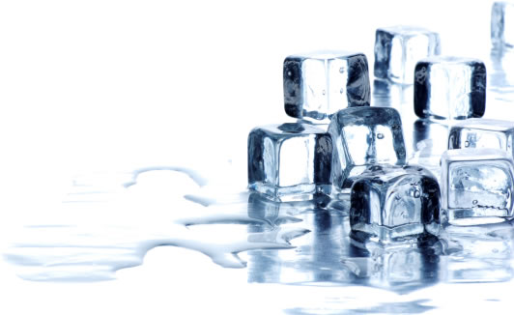
About ZoomEssence
Zooming® Low-Temperature Drying
is Designed for
Heat-Sensitive Flavors and Naturals
Delivering Unmatched Quality in Aroma and Taste
Notes:
Our focus at ZoomEssence is to deliver the highest quality in aroma & taste of flavors and naturals ingredients using our
Low-Temperature drying process called Zooming.

Slide 3

About ZoomEssence
Headquarters & Creation Center, Hebron, KY
Flavorists
R&D Scientists
Beverage & Culinary Applications
Analytical & Regulatory
Sales & Customer Service
5 Drying Systems in 2 Manufacturing Facilities
Hebron, KY
Sayreville, NJ

Slide 4

About ZoomEssence
Lead Time for First-Time Production is 4 to 5 weeks
Depending on Availability of Raw Materials
Lead Time for Additional Orders is 3 weeks
Stocking Agreements are Available
Minimum Order 20 Kgs
Pack Size 10 Kgs Box

Slide 5
It’s About Zooming Efficiency
Traditional Spray Dry
CoolZoom Powder
Dried @Temperatures
350-400F
Dried @Temperature ~110F
30%+ Loss of Flavor & Aroma Actives
95 to 100% Retention of Flavor & Aroma Actives
Particle Size Avg 50micron
Particle Size Avg 100micron
Bulk Density
High Surface Area
Bulk Density
Fully Dense, Low Surface Area

Slide 6
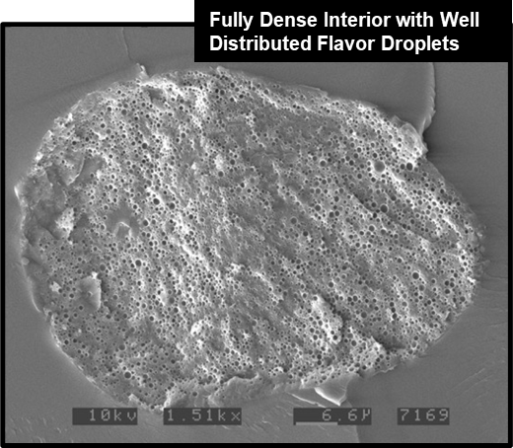
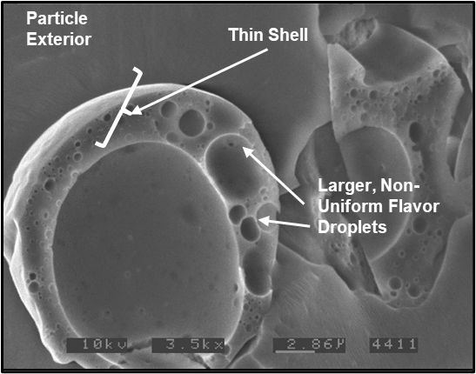
CoolZoom Science Drives Performance
Typical High Heat Spray Dried Powder
CoolZoom Powder
Air Pocket

Slide 7

CoolZoom Has Better Dispersibility
CoolZoom Spray Dry
0.50g Spray Dry / 250ml Water

Slide 8
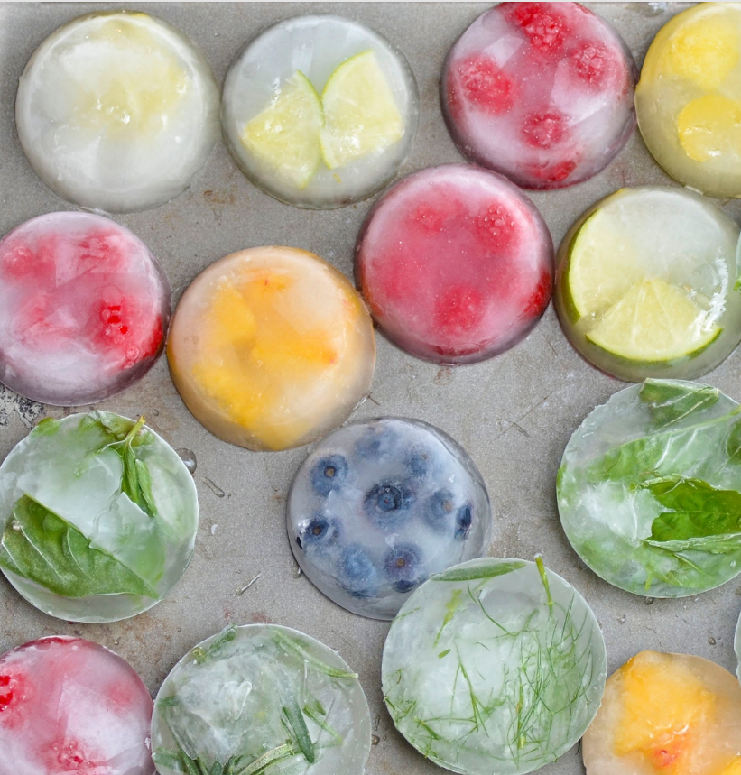
TASTE MATTERS

Slide 9
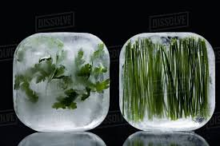

The Challenge
ZoomEssence
Fresh Flavor & Aroma of Spices and Herbs are Inconsistent or Unavailable
Oils / Oleoresins / Extracts Flavors Fade Over Time
Challenging or Inappropriate to Use in Application

Slide 10

ZoomEssence
We’ve Done the Work for You
We Formulated Differently to Optimize Flavor and Aroma
Encapsulated for Enhanced Stability
Chef-Approved Profiles and Performance Tested

Slide 11
Totally Derived from Natural Source
Oils, Extracts,
Oleos, Essences
-Herbs
-Citrus
-Spices
-Vegetables
80% of taste is aroma
Non-GMO
Gluten-Free
Vegetarian
Vegan
Kosher
Clean Label / Free From
Organic Certifiable
& Certified
(when requested)
No “Flavor” on Your Label
-Using heat distorts to create your powder flavor destroys the natural volatiles-
Notes:
We offer a wide variety of flavors that meet your labeling requirements.

Slide 12

ZoomEssence
Better Stability
More Flavor & Aroma
More Aroma & Taste
Significant Performance
In Foods
Beverage
Capabilities
Authentic
Dispersible
& Soluble
Notes:
Better Stability due to encapsulation

Slide 13

Flavored Ricotta Alternative
Tasting Sheets

Slide 14
ZoomEssence
Caramelized Onion
Ricotta Alternative
PR005228
Ingredient | Supplier | Amount (g)
Ricotta Alternative, Almond Milk | Kite Hill | 97.200
Natural Caramelized Onion Type Flavor Ze40812 | ZoomEssence | 2.800
 |  | 100.00

Slide 15
Z
o
o
m
Sales Contact:
Pat Horning
VP Sales
513-827-7522
phorning@zoomessence.com
E
s
s
e
n
c
e

